Slide 1

Some
Object-Oriented Design
Principles
-Open Closed Princible(OCP)
-Liskov’s Substitution Princible(LSP)
Huseyin Sarkisla – Computer Engineering / Senior Student

Slide 2
The Open-Closed Principle:
Software Entities Should Be Open For Extension, Yet Closed For Modification

Slide 3
The Open-Closed Principle
The Open-Closed Principle (OCP) says that we should attempt to design modules that never need to be changed
To extend the behavior of the system, we add new code. We do not modify old code.
Modules that conform to the OCP meet two criteria:
Open For Extension - The behavior of the module can be extended to meet new requirements
Closed For Modification - the source code of the module is not allowed to change
How can we do this?
Abstraction
Polymorphism
Inheritance
Interfaces

Slide 4
The Open-Closed Principle
It is not possible to have all the modules of a software system satisfy the OCP, but we should attempt to minimize the number of modules that do not satisfy it
The Open-Closed Principle is really the heart of OO design
Conformance to this principle yields the greatest level of reusability and maintainability
The Open Close Principle states that the design and writing of the code should be done in a way that new functionality should be added with minimum changes in the existing code. The design should be done in a way to allow the adding of new functionality as new classes, keeping as much as possible existing code unchanged

Slide 5
The Open-Closed Principle
A clever application design and the code writing part should take care of the frequent changes that are done during the development and the maintaining phase of an application. Usually, many changes are involved when a new functionality is added to an application. Those changes in the existing code should be minimized, since it's assumed that the existing code is already unit tested and changes in already written code might affect the existing functionality in an unwanted manner

Slide 6
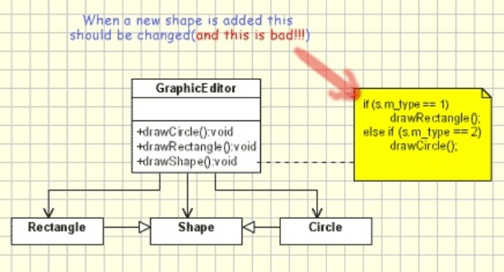
Open-Closed Principle Example
Bellow is an example which violates the Open Close Principle. It implements a graphic editor which handles the drawing of different shapes. It's obviously that it does not follow the Open Close Principle since the GraphicEditor class has to be modified for every new shape class that has to be added.

Slide 7
Open-Closed Principle Example (Continued)
The code for bad example of OCP is below:
// Open-Close Principle - Bad example
class GraphicEditor {
public void drawShape(Shape s) {
if (s.m_type==1)
drawRectangle(s);
else if (s.m_type==2)
drawCircle(s);
}
public void drawCircle(Circle r) {....}
public void drawRectangle(Rectangle r) {....}
}
class Shape {
int m_type;
}
class Rectangle extends Shape {
Rectangle() {
super.m_type=1;
}
}
class Circle extends Shape {
Circle() {
super.m_type=2;
}
}

Slide 8
Open-Closed Principle Example (Continued)
There are several disadvantages:
for each new shape added the unit testing of the GraphicEditor should be redone.
when a new type of shape is added the time for adding it will be high since the developer who add it should understand the logic of the GraphicEditor.
adding a new shape might affect the existing functionality in an undesired way, even if the new shape works perfectly

Slide 9
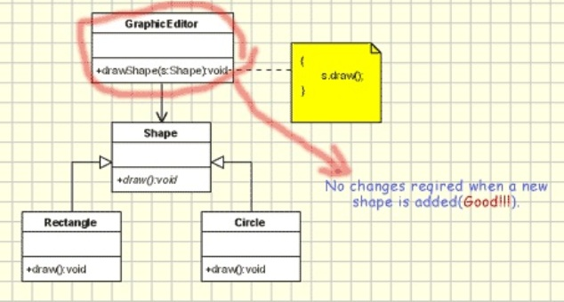
Open-Closed Principle Example (Continued)
Bellow is a example which supports the Open Close Principle. In the new design we use abstract draw() method in GraphicEditor for drawing objects, while moving the implementation in the concrete shape objects.

Slide 10
Open-Closed Principle Example (Continued)
// Open-Close Principle - Good example
class GraphicEditor {
public void drawShape(Shape s) {
s.draw();
}
}
class Shape {
abstract void draw();
}
class Rectangle extends Shape {
public void draw() {
// draw the rectangle
}
}

Slide 11
Open-Closed Principle Example (Continued)
With this solution:
no unit testing required.
no need to understand the source code from GraphicEditor.
since the drawing code is moved to the concrete shape classes, it's a reduced risk to affect old functionality when new functionality is added.

Slide 12
The Liskov Substitution Principle: Functions That Use References To Base (Super) Classes Must Be
Able To Use Objects Of Derived (Sub) Classes Without Knowing It

Slide 13
The Liskov Substitution Principle
The Liskov Substitution Principle (LSP) seems obvious given all we know about polymorphism
For example:
public void drawShape(Shape s) { // Code here.
}
The drawShape method should work with any subclass of the Shape superclass (or, if Shape is a Java interface, it should work with any class that implements the Shape interface)
But we must be careful when we implement subclasses to insure that we do not unintentionally violate the LSP

Slide 14
The Liskov Substitution Principle
If a function does not satisfy the LSP, then it probably makes explicit reference to some or all of the subclasses of its superclass. Such a function also violates the Open-Closed Principle, since it may have to be modified whenever a new subclass is created.

Slide 15
LSP Example
Consider the following Rectangle class:
// Violation of Likov's Substitution Principle
class Rectangle
{
protected int m_width;
protected int m_height;
public void setWidth(int width){
m_width = width;
}
public void setHeight(int height){
m_height = height;
}
public int getWidth(){
return m_width;
}
public int getHeight(){
return m_height;
}
public int getArea(){
return m_width * m_height;
}
}

Slide 16
LSP Example (Continued)
Now, how about a Square class? Clearly, a square is a rectangle, so the Square class should be derived from the Rectangle class, right? Let's see!
Observations:
A square does not need both a width and a height as attributes, but it will inherit them from Rectangle anyway. So, each Square object wastes a little memory, but this is not a major concern.
The inherited setWidth() and setHeight() methods are not really appropriate for a Square, since the width and height of a square are identical. So we'll need to override setWidth() and setHeight(). Having to override these simple methods is a clue that this might not be an appropriate use of inheritance!

Slide 17
LSP Example (Continued)
Here's the Square class:
// A Square class.
public class Square extends Rectangle {
public Square(double s) {super(s, s);}
public void setWidth(double w) { super.setWidth(w);
super.setHeight(w);
}
public void setHeight(double h) {
super.setHeight(h);
super.setWidth(h);
}
}

Slide 18
LSP Example (Continued)
Everything looks good. But check this out!
public class TestRectangle {
// Define a method that takes a Rectangle reference. public static void testLSP(Rectangle r) {
r.setWidth(4.0);
r.setHeight(5.0);
System.out.println("Width is 4.0 and Height is 5.0" +
", so Area is " + r.area());
if (r.area() == 20.0)
System.out.println("Looking good!\n"); else
System.out.println("Huh?? What kind of rectangle is this??\n");
}

Slide 19
LSP Example (Continued)
public static void main(String args[]) {
//Create a Rectangle and a Square Rectangle r = new Rectangle(1.0, 1.0); Square s = new Square(1.0);
// Now call the method above. According to the
// LSP, it should work for either Rectangles or
// Squares. Does it??
testLSP(r);
testLSP(s);
}
}

Slide 20
LSP Example (Continued)
Test program output:
Width is 4.0 and Height is 5.0, so Area is 20.0 Looking good!
Width is 4.0 and Height is 5.0, so Area is 25.0 Huh?? What kind of rectangle is this??
Looks like we violated the LSP!

Slide 21
LSP Example (Continued)
What's the problem here? The programmer of the testLSP() method made the reasonable assumption that changing the width of a Rectangle leaves its height unchanged.
Passing a Square object to such a method results in problems, exposing a violation of the LSP
The Square and Rectangle classes look self consistent and valid. Yet a programmer, making reasonable assumptions about the base class, can write a method that causes the design model to break down
Solutions can not be viewed in isolation, they must also be viewed in terms of reasonable assumptions that might be made by users of the design

Slide 22
LSP Example (Continued)
A mathematical square might be a rectangle, but a Square object is not a Rectangle object, because the behavior of a Square object is not consistent with the behavior of a Rectangle object!
Behaviorally, a Square is not a Rectangle! A Square object is not polymorphic with a Rectangle object.

Slide 23
The Liskov Substitution Principle
In order for the LSP to hold (and with it the Open-Closed Principle) all subclasses must conform to the behavior that clients expect of the base classes they use
A subtype must have no more constraints than its base type, since the subtype must be usable anywhere the base type is usable
If the subtype has more constraints than the base type, there would be uses that would be valid for the base type, but that would violate one of the extra constraints of the subtype and thus violate the LSP!
The guarantee of the LSP is that a subclass can always be used wherever its base class is used!

Slide 24
What are the benefits of using OCP and LCP & Conclusions
Benefits
Stability – If you don’t change existing code, you can’t break it.
Error Reduction – If you always have to make more or less the same changes over and over again you might make a mistake.
Clarity and Readability
Conclusions
Like every principle OCP and LSP are only principles. Making a flexible design involves additional time and effort spent for it and it introduce new level of abstraction increasing the complexity of the code. So these principles should be applied in those area which are most likely to be changed.

Slide 25
And last word…
ThAnKs
☺

